Slide 1
Decision Tree

Slide 2
Decision Tree Classification
Decision tree
A flow-chart-like tree structure
Internal node denotes a test on an attribute
Branch represents an outcome of the test
Leaf nodes represent class labels or class distribution
Decision tree generation consists of two phases
Tree construction
At start, all the training examples are at the root
Partition examples recursively based on selected attributes
Tree pruning
Identify and remove branches that reflect noise or outliers
Use of decision tree: Classifying an unknown sample
Test the attribute values of the sample against the decision tree

Slide 3
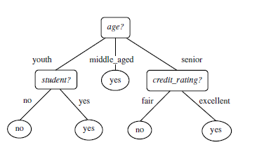
Example

Slide 4
Decision Tree for Classification
Let’s consider a tuple X for which the associated class label is unknown
The attribute values of that tuple are tested against the decision tree
A path is traced from the root to a leaf node, which holds the class prediction for the given tuple

Slide 5
Decision Tree Induction
During the late 1970s and early 1980s, J. Ross Quinlan, a researcher in machine learning, developed a decision tree algorithm known as ID3 (Iterative Dichotomiser)
Quinlan later presented C4.5 (a successor of ID3)
ID3, and C4.5 adopt a greedy approach in which decision trees are constructed in a top-down recursive divide-and-conquer manner
These approaches starts with a training set of tuples and their associated class labels
The training set is recursively partitioned into smaller subsets as the tree is being built

Slide 6
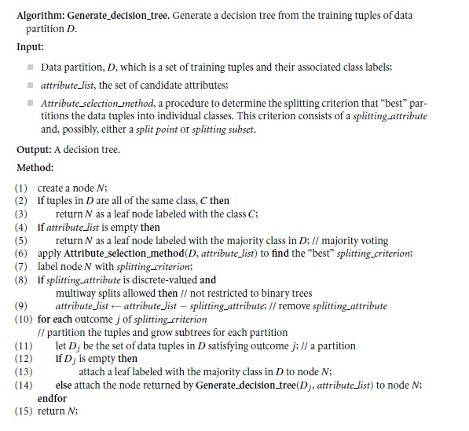
Decision Tree Algorithm

Slide 7
Strategy Behind the Algorithm
The algorithm is called with three parameters: D, attribute list, and Attribute selection method.
The tree starts as a single node, N, representing the training tuples in D
the algorithm calls Attribute selection method to determine the splitting criterion.
The splitting criterion tells us which attribute to test at node N by determining the “best” way to separate or partition the tuples in D into individual classes
the splitting criterion indicates the splitting attribute and may also indicate either a split-point or a splitting subset.
The node N is labeled with the splitting criterion, which serves as a test at the node
A branch is grown from node N for each of the outcomes of the splitting criterion.
If A be the splitting attribute and A has v distinct values, {a₁, a₂, : : : , a_{v}}, based on the training data, then there are following three possibilities:
1. A is discrete-valued
2. A is continuous-valued
3. A is discrete-valued and a binary tree must be produced

Slide 8
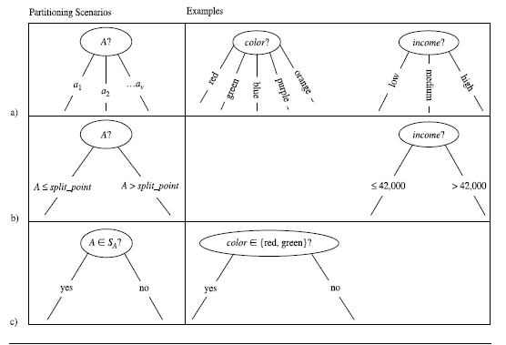

Slide 9
How to determine the Best Split
Greedy approach:
Nodes with homogeneous class distribution are preferred
Need a measure of node impurity:
Non-homogeneous,
High degree of impurity
Homogeneous,
Low degree of impurity

Slide 10
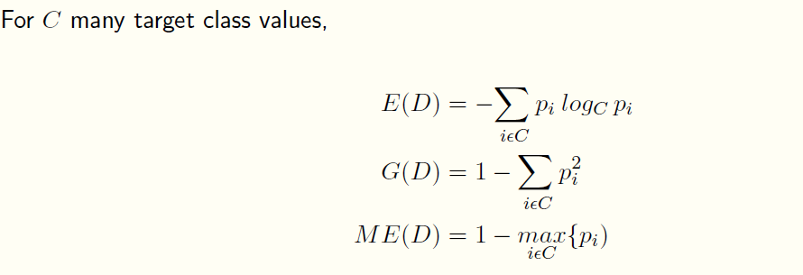
Measures of Node Impurity
Entropy
Gini Index
Misclassification error

Slide 11
Examples for computing Entropy
P(C1) = 0/6 = 0 P(C2) = 6/6 = 1
Entropy = – 0 log 0 – 1 log 1 = – 0 – 0 = 0
P(C1) = 1/6 P(C2) = 5/6
Entropy = – (1/6) log₂ (1/6) – (5/6) log₂ (1/6) = 0.65
P(C1) = 2/6 P(C2) = 4/6
Entropy = – (2/6) log₂ (2/6) – (4/6) log₂ (4/6) = 0.92

Slide 12
Attribute Selection Measure
An attribute selection measure is a heuristic for selecting the splitting criterion that “best” separates a given data partition, D, of class-labeled training tuples into individual classes
If we were to split D into smaller partitions according to the outcomes of the splitting criterion, ideally each partition would be pure, i.e. all of the tuples that fall into a given partition would belong to the same class
There are three popular attribute selection measures—information gain, gain ratio, and gini index.
Let’s assume D, the data partition, be a training set of class-labeled tuples and Let’s also suppose that the class label attribute has m distinct values defining m distinct classes, C_{i} (for i = 1, : : : , m)
If C_{i,D} be the set of tuples of class C_{i} in D, then |D| and |C_{i,D} | denote the number of tuples in D and C_{i,D} respectively

Slide 13

Information Gain as a Splitting Criteria
ID3 uses information gain as its attribute selection measure
The attribute with the highest information gain is chosen as the splitting attribute for a node N
The expected information needed to classify a tuple in D is given by
where pi is the probability that an arbitrary tuple in D belongs to class Ci and is estimated
by |C_{i,D} | / |D|
Info(D) is also known as the entropy of D

Slide 14

Information Gain as a Splitting Criteria
Now, suppose we were to partition the tuples in D on some attribute A having v distinct values, {a₁, a₂, : : : , a_{v}}, as observed from the training data
Attribute A can be used to split Di nto v partitions or subsets, {D1, D2, : : : , Dv}, where Dj contains those tuples in D that have outcome aj of A
Ideally, we would like this partitioning to produce an exact classification of the tuples
How much more information would we still need (after the partitioning) in order to arrive at an exact classification?
This amount is measured by

Slide 15
Information Gain as a Splitting Criteria
Information gain is defined as the difference between the original information requirement (i.e., based on just the proportion of classes) and the new requirement (i.e., obtained after partitioning on A)
Gain(A) = Info(D) - Info_{A}(D)
Gain(A) tells us how much would be gained by branching on A
The attribute A with the highest information gain, (Gain(A)), is chosen as the splitting attribute at node N
This is equivalent to saying that we want to partition on the attribute A that would do the “best classification,” so that the amount of information still required to finish classifying the tuples is minimal (i.e., minimum Info_{A}(D))
The attribute which gives the highest information gain is picked as the splitting attribute
=> increases the purity of data

Slide 16
Splitting Based on INFO...
Information Gain:
Parent Node, p is split into k partitions;
n_{i} is number of records in partition i
Measures Reduction in Entropy achieved because of the split. Choose the split that achieves most reduction (maximizes GAIN)
Used in ID3 and C4.5
Disadvantage: Tends to prefer splits that result in large number of partitions, each being small but pure.

Slide 17
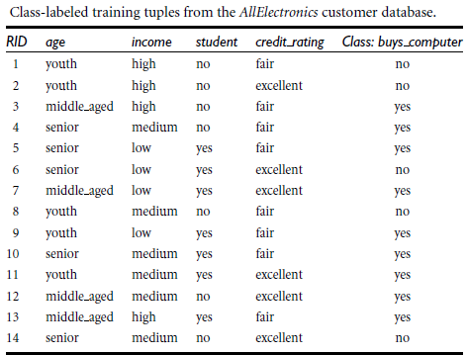
Example

Slide 18

Induction of a decision tree using Information Gain
The class label attribute, buys_computer, has two distinct values (namely, {yes, no})
therefore, there are two distinct classes (that is, m = 2)
There are nine tuples of class yes and five tuples of class no
expected information needed to classify a tuple in D is computed as follows:

Slide 19
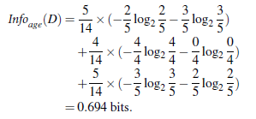

Example contd..
Let’s find the expected information required for attribute named as ‘age’
For the age category youth, there are two yes tuples and three no tuples
For the category middle aged, there are four yes tuples and zero no tuples
For the category senior, there are three yes tuples and two no tuples

Slide 20
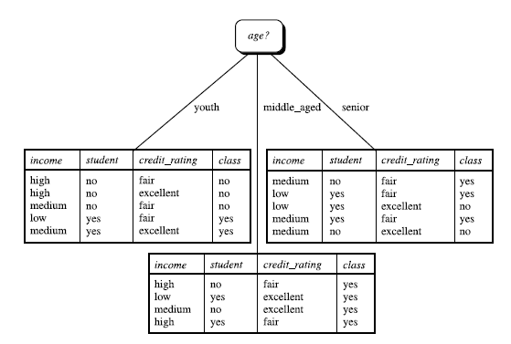
Example contd..
Similarly, we can compute Gain(income) = 0.029 bits, Gain(student) = 0.151 bits, and Gain(credit rating) = 0.048 bits
Since age has the highest information gain among the attributes, it is selected as the splitting attribute

Slide 21
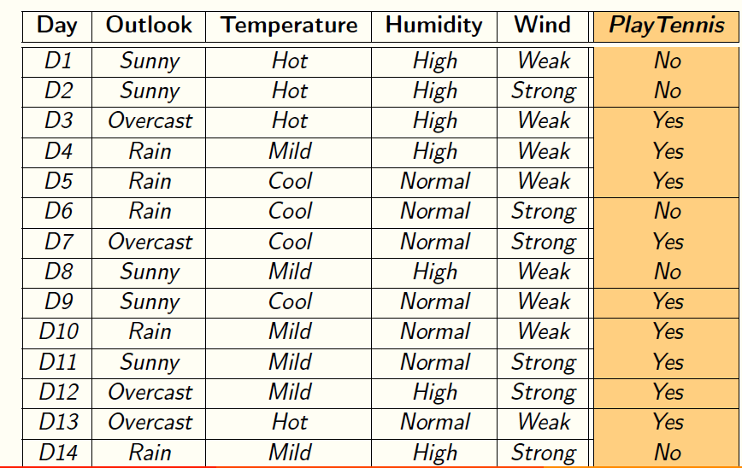
Example

Slide 22
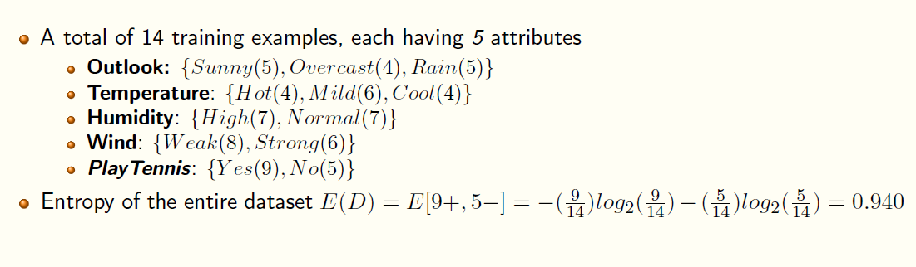
Example

Slide 23
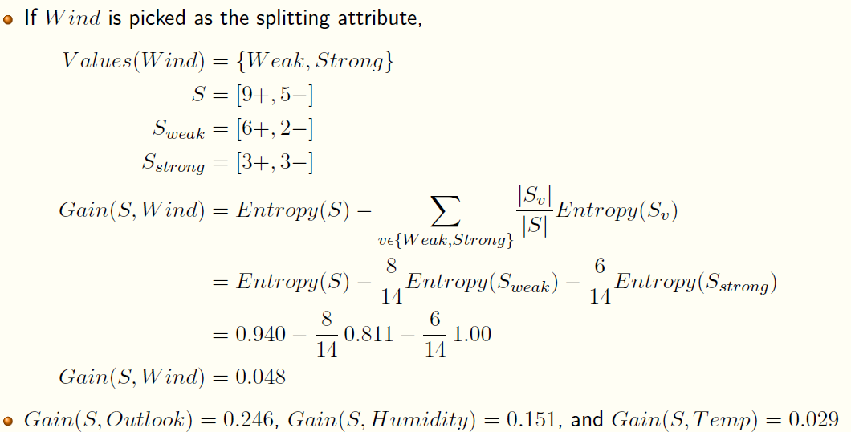
Example

Slide 24
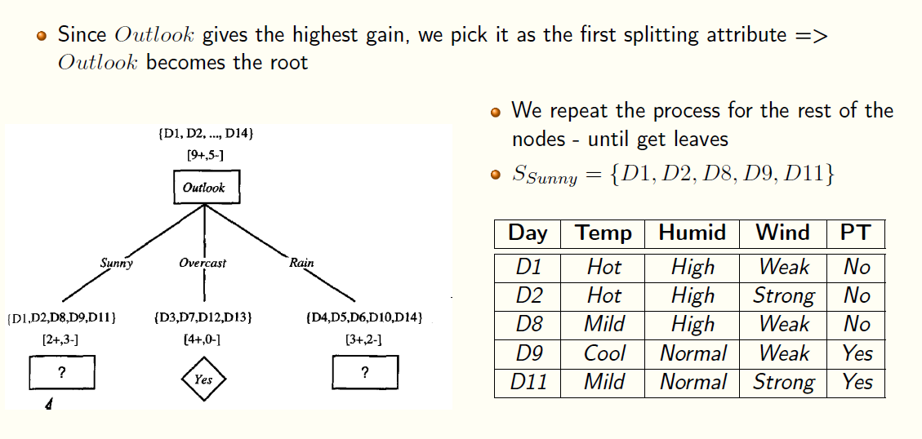
Example

Slide 25
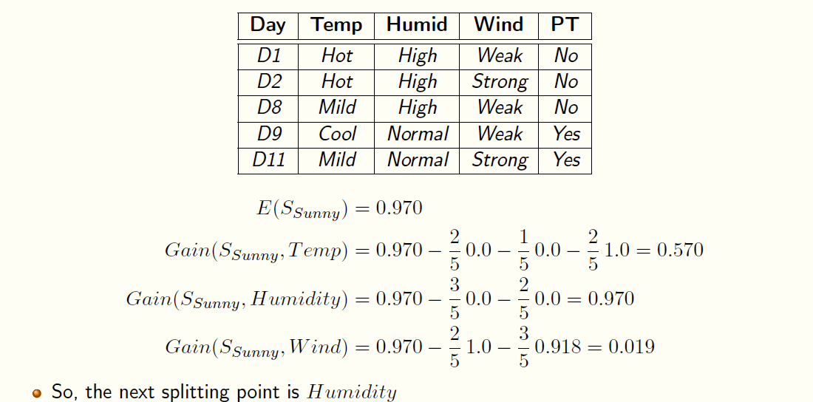
Example

Slide 26
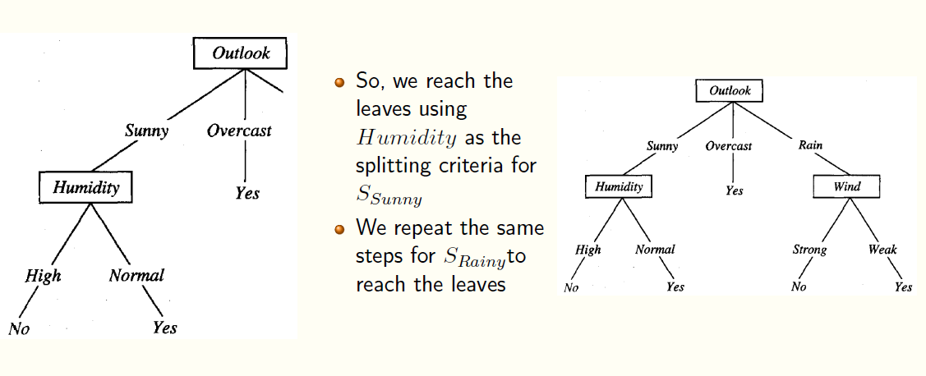
Example

Slide 27
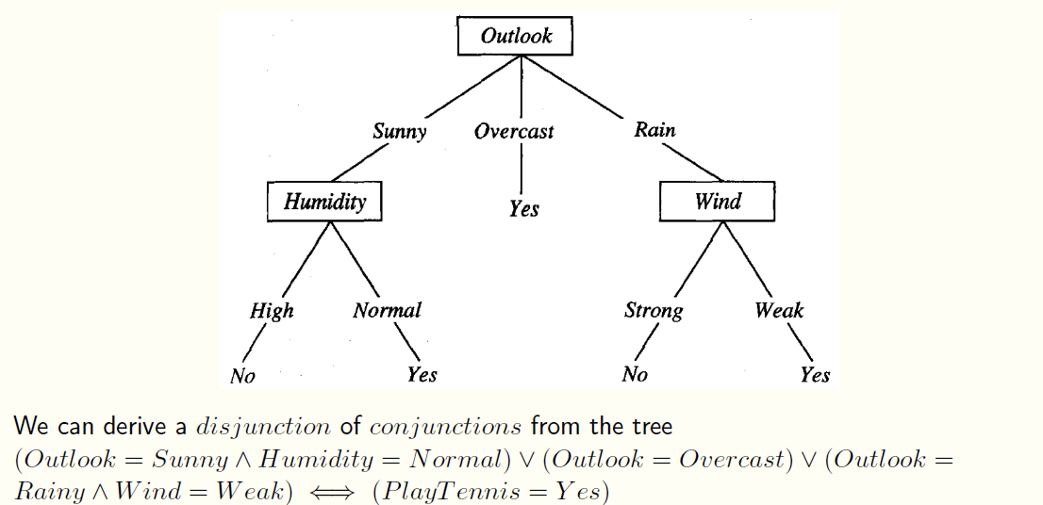
Example

Slide 28
Information Gain of Continuous valued attribute
For such a scenario, we must determine the “best” split-point for A, where the split-point is a threshold on A
sort the values of A in increasing order
Typically, the midpoint between each pair of adjacent values is considered as a possible split-point
Therefore, given v values of A, then v – 1 possible splits are evaluated
For example, the midpoint between the values a_{i} and a_{i+1} of A is (a_{i}+a_{i+1} ) / 2
For each possible split-point for A, we evaluate Info_{A}(D), where the number of partitions is two, i.e. v = 2 (or j = 1;2)
The point with the minimum expected information requirement for A is selected as the split point for A
D1 is the set of tuples in D satisfying A ≤ split_point, and D2 is the set of tuples in D satisfying A > split_point

Slide 29
Continuous Attributes: Computing Gini Index
Use Binary Decisions based on one value
Several Choices for the splitting value
Number of possible splitting values = Number of distinct values
Each splitting value has a count matrix associated with it
Class counts in each of the partitions, A < v and A ≥ v
Simple method to choose best v
For each v, scan the database to gather count matrix and compute its Gini index
Computationally Inefficient! Repetition of work.

Slide 30
Continuous Attributes: Computing Gini Index...
For efficient computation: for each attribute,
Sort the attribute on values
Linearly scan these values, each time updating the count matrix and computing gini index
Choose the split position that has the least gini index
Sorted Values
Split Positions

